Slide 1
Workout Smarter: Personal Plans and Burn Predictions
Capstone Project
Katrina Booth

Slide 2
Agenda
Background
Project Objectives
Exploration
Feature Engineering
Model Selection
Model Evaluation
Demo
Project Limitations
Conclusion
Q&A

Slide 3

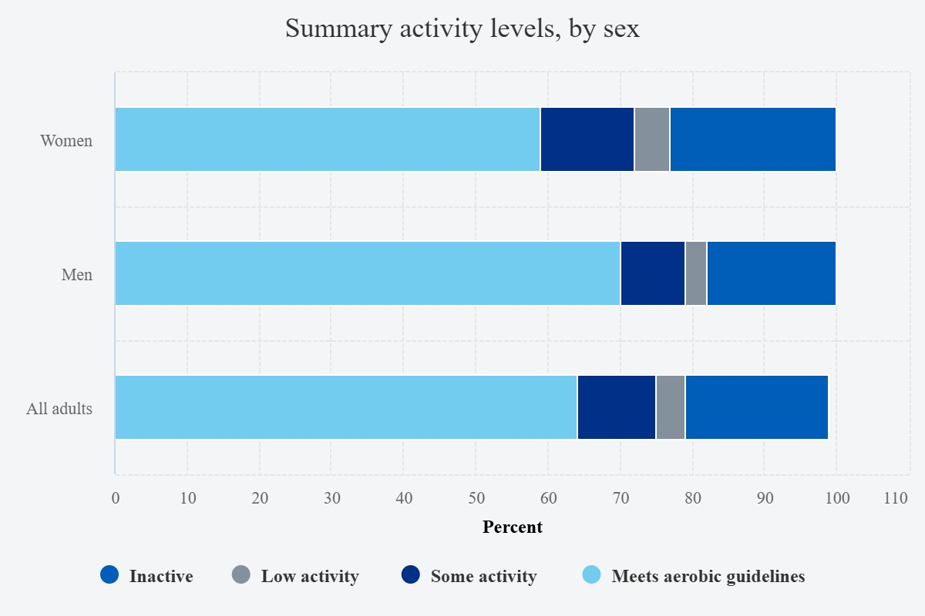

Background
Limited time → Need efficient workouts
Repetitive exercises → Lack of variety & muscle engagement
Uncertain calorie burn → No expensive tracker
2021 Health Survey for England, https://digital.nhs.uk/data-and-information/publications/statistical/health-survey-for-england/2021-part-2/physical-activity

Slide 4


Project Objectives
Workout Recommender:
Recommend exercises that maximize calories burned based on user preferences.
2. Calorie Prediction Model:
Estimate calories burned during any given workout.

Slide 5
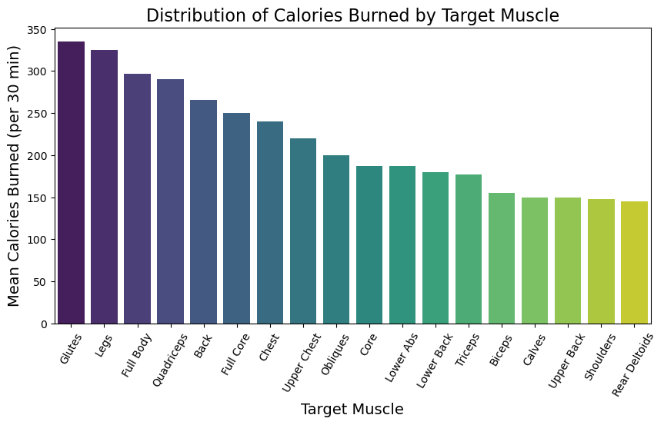
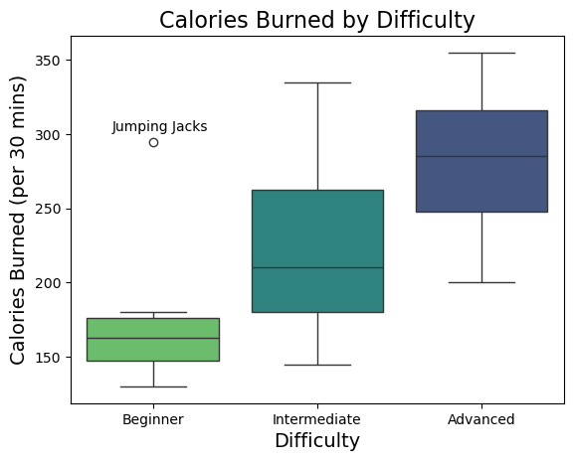
Exploration
Calorie burn increases with difficulty.
Advanced exercises burn over 100 more calories than beginner exercises on average.
Exercises targeting larger muscles tend to burn the most calories.
Lower-body exercises, such as those targeting glutes and legs are especially effective.

Slide 6

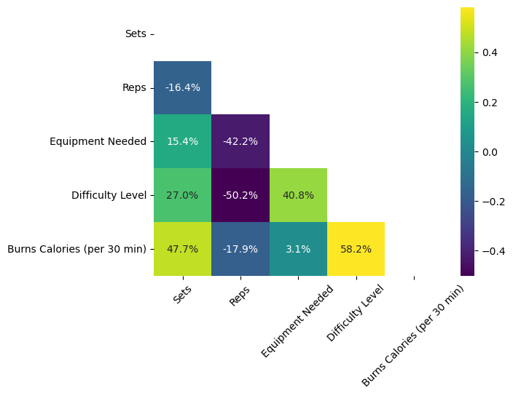
Feature Engineering
‘Equipment Needed’: Map No: 0, Yes: 1.
‘Difficulty Level’: One-hot encoding performs better that mapping.
‘Target Muscle Group’: Split into individual muscles and generalise them into broader categories.
‘Total Reps’: Multiply ‘Reps’ and ‘Sets’.
Min-Max Scaler applied to all features.

Slide 7
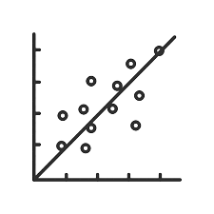

Calorie Prediction Model: Selection
MODEL SELECTION
Models tried: Linear regression, polynomial regression, decision tree regression, KNN.
Linear regression produced the best performance metrics (RMSE and MAPE).
Used L2 regularization to prevent overfitting.
FEATURE SELECTION
Recursive feature elimination (RFE) helped eliminate less impactful features to reduce model complexity.
Enhances generalizability by reducing overfitting.

Slide 8
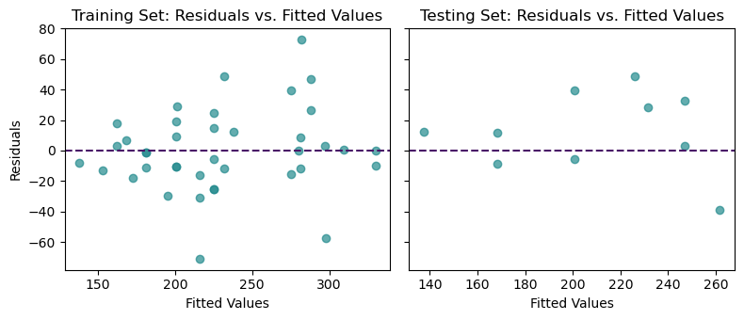
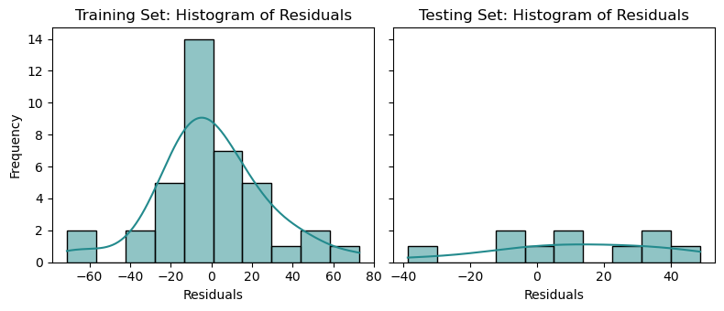
Calorie Prediction Model: Evaluation
R² : 0.81
P-values : All below 0.05, except one at 0.093*.
Training data
RMSE : 27
MAPE : 9%
Testing data
RMSE : 28
MAPE : 10%
*For the equivalent statsmodels linear regression model

Slide 9
Demo! https://hjdf-capstone-project-rxeseyny7bq7tvpjk6kypn.streamlit.app/

Slide 10


Project Limitations
The dataset only contains 50 exercises.
AI generated dataset.
Physical characteristic limitations.
Assumes everyone’s goal is to maximise the number of calories burned.

Slide 11
Conclusion
Identified patterns in calorie burn based on difficulty levels, muscle groups, and exercise intensity.
Developed a workout recommender and calorie prediction model using linear regression.
Achieved an R² of 0.81, indicating strong predictive performance.
Created a cost-effective tool for personalized fitness guidance without the need for expensive devices.

Slide 12
Thank You For Listening! Any Questions?

